Slide 1
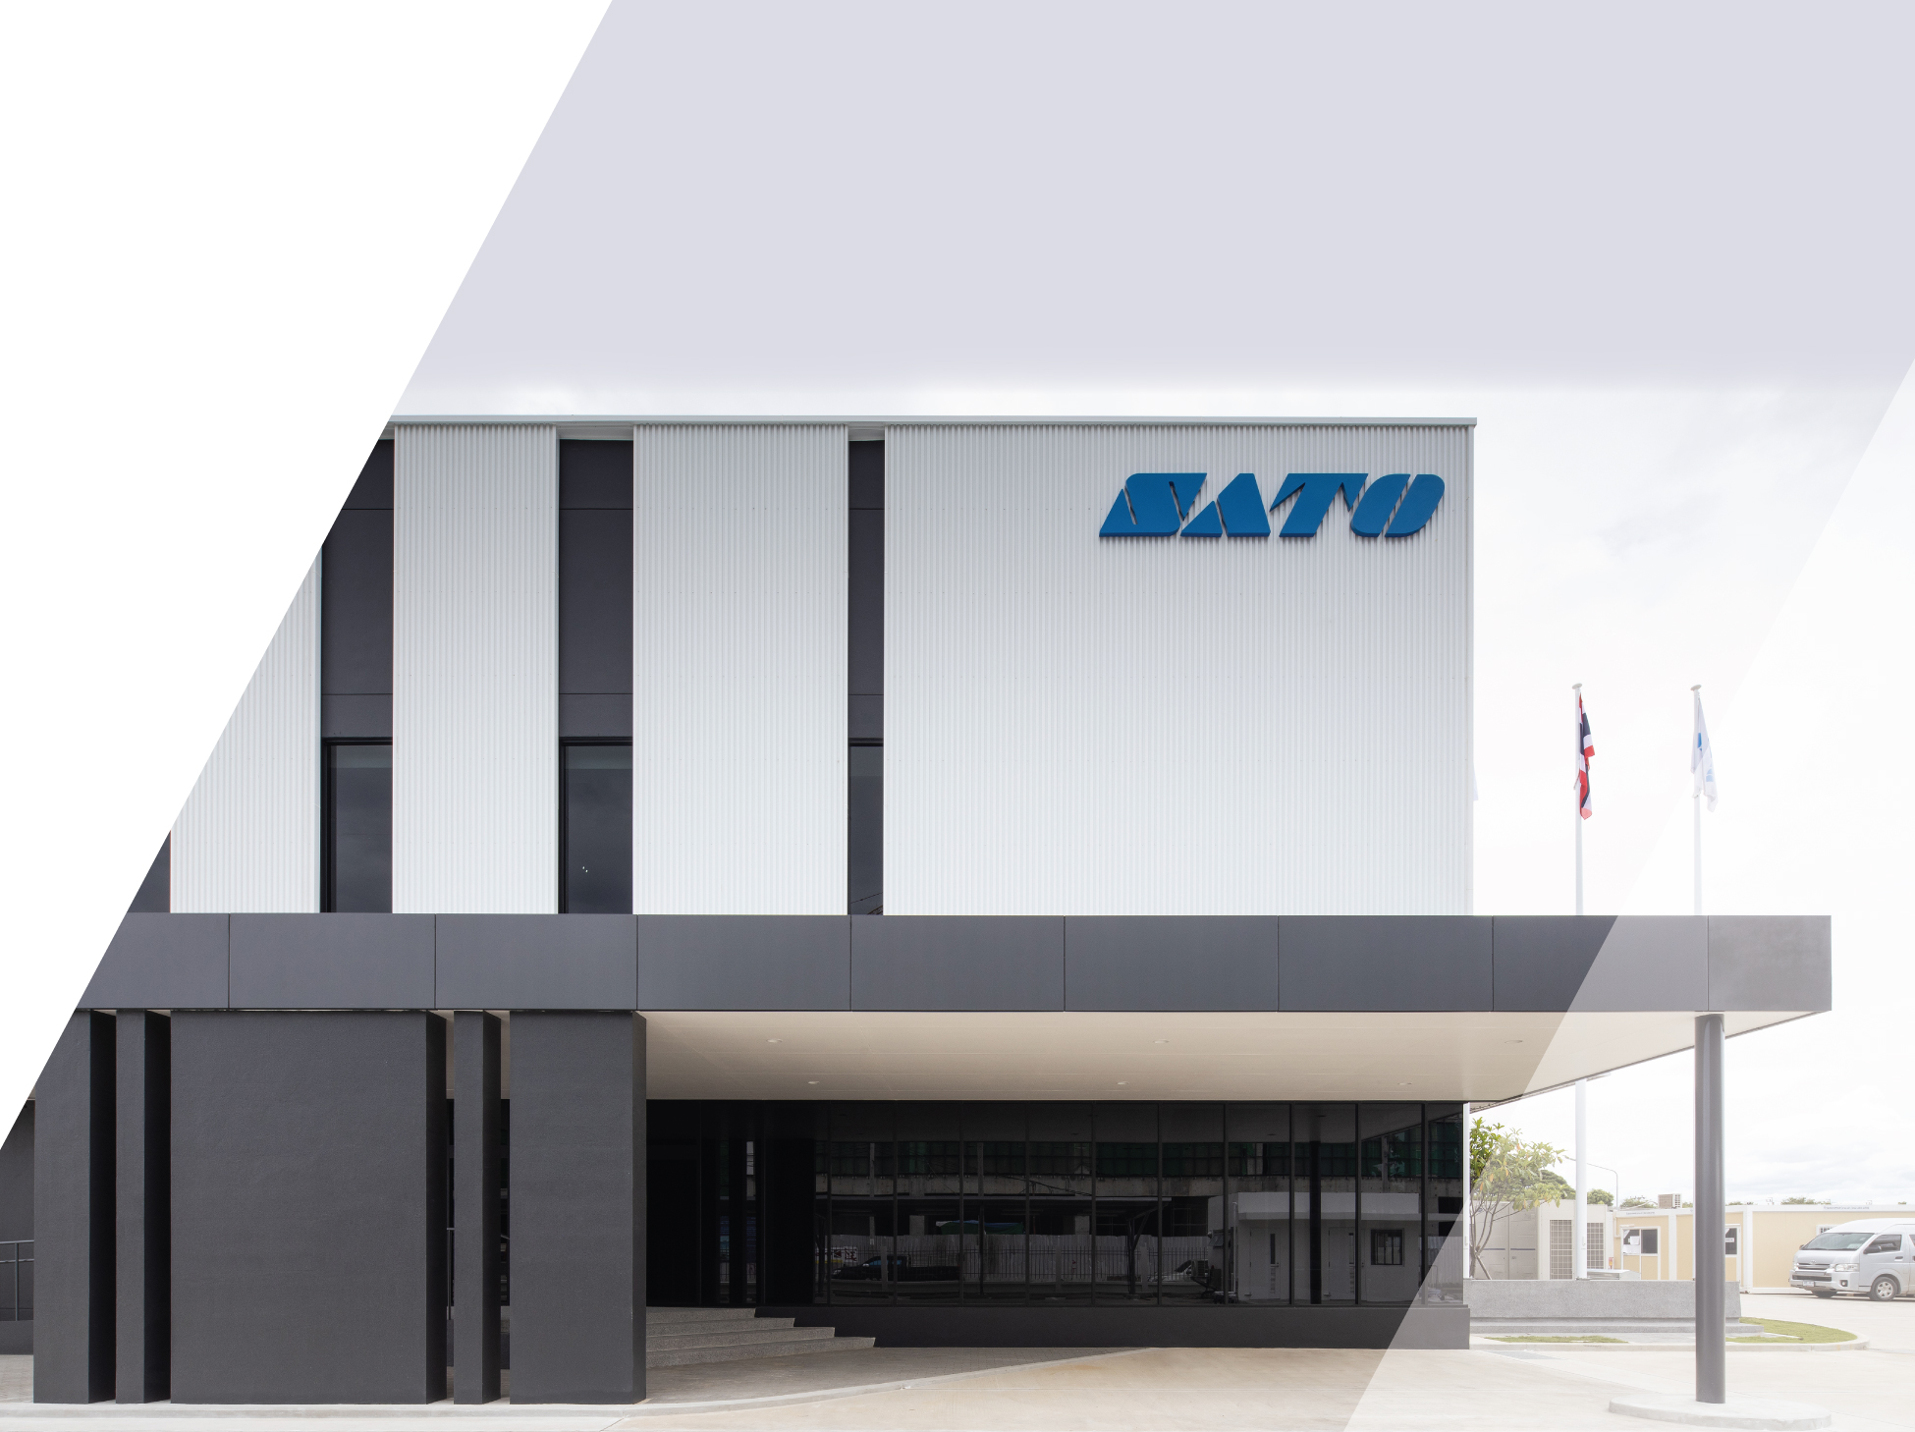

COMPANY PROFILE
We give every ‘thing’ its own ID
so it connects with the world

Slide 2


SATO Holdings Corporation
Overview
Location | Tamachi Station Tower N, 3-1-1 Shibaura, Minato-ku, Tokyo 108-0023, Japan
Established | 1940
Incorporated | 1951
Representative director | Hiroyuki Konuma, President and Group CEO
Paid-in capital | ¥8.4 billion
Employees | 5,744
Consolidated net sales | ¥143.4 billion
*Corporate data (As of March 31, 2024)

Slide 3
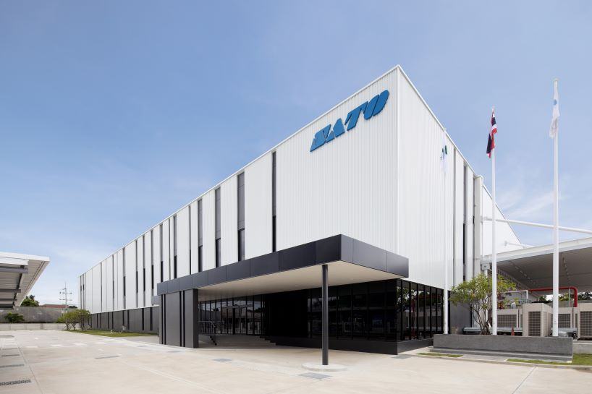
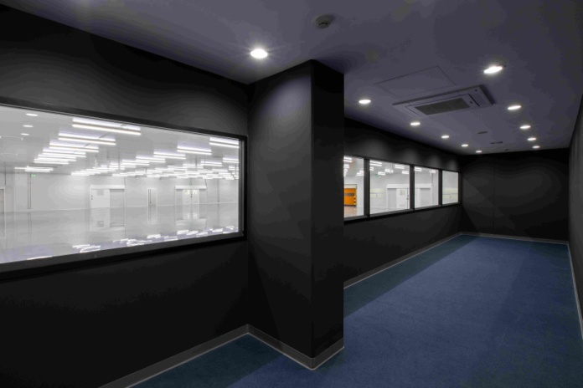
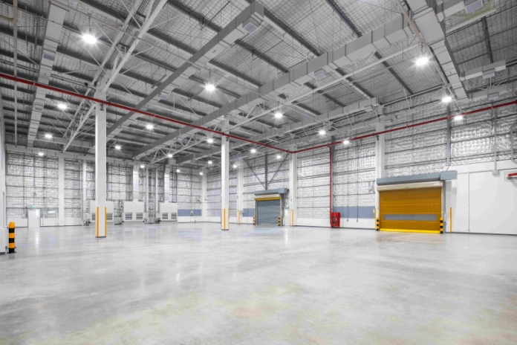
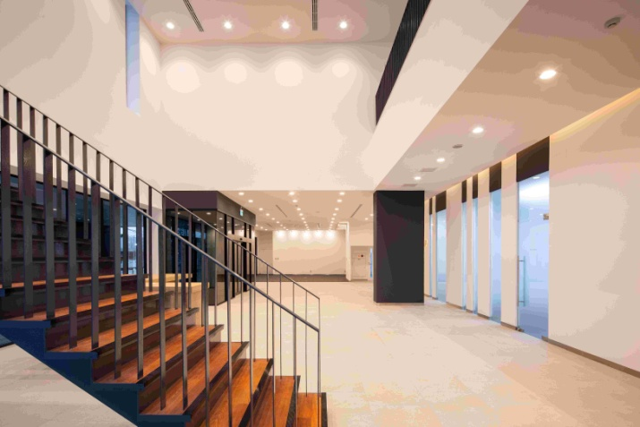
Head Office
And Label Factory
Location : 186, Moo4, Praksa Road, Tambol Praksa, Amphur Muang, Samutprakarn 10280
Employees : Consolidated 189
Factory Information
Certificate | ISO9001,UL certificate
Site area | 4,518㎡ （Production floor 2,360㎡, Warehouse 980㎡, Office 1,178㎡ ）
Employees | 76 (Label Production)

Slide 4
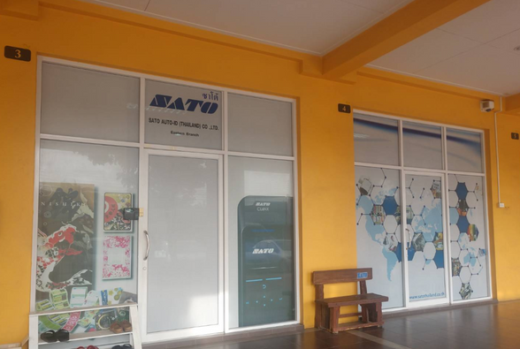
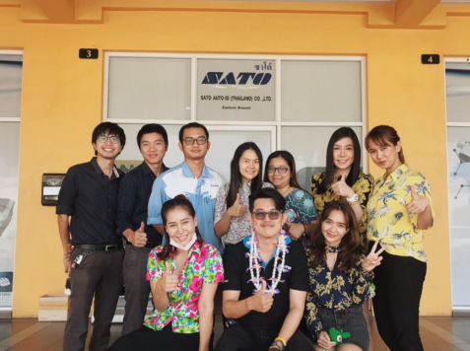
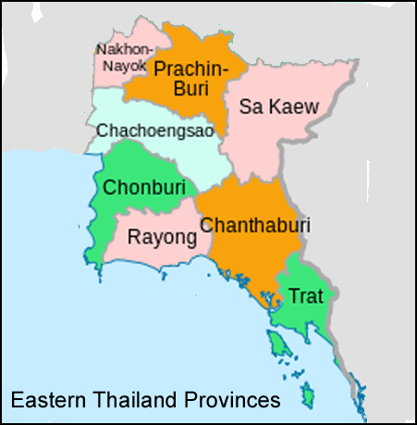
Eastern Branch
Sriracha Office
Location : 483/250, Room 103-104, Moo 3 Nhongkham, Sriracha, Chonburi 20110
Employees : Consolidated 14

Slide 5
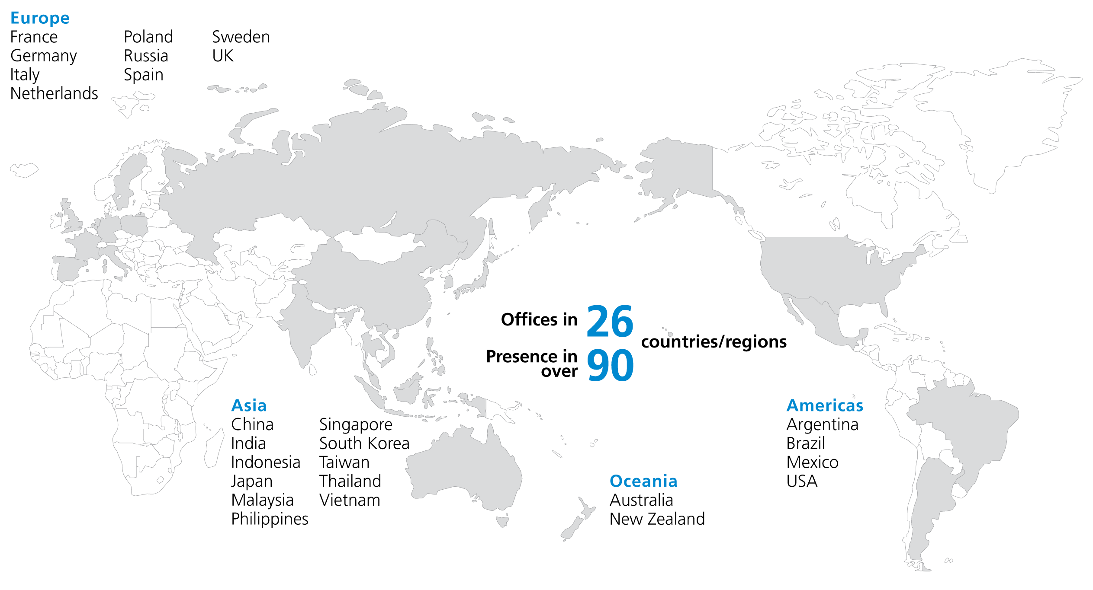
Global network

Slide 6

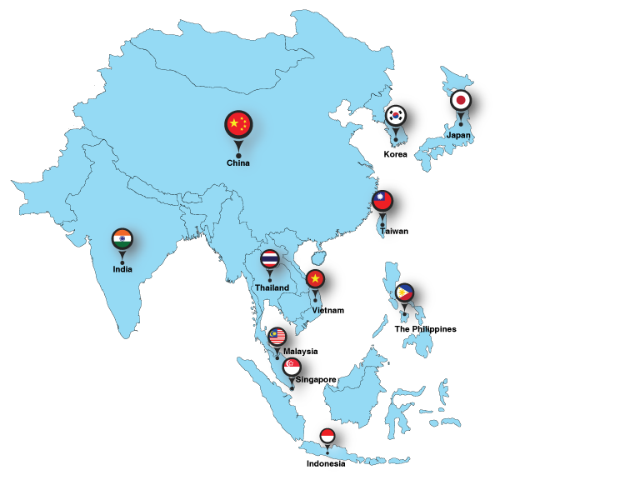
SATO in Asia Pacific
Thailand : SATO Auto-ID (Thailand) Co., Ltd.
Singapore : SATO Asia Pacific Pte. Ltd
China : SATO Shanghai Co., Ltd.
India : SATO Argox India Pvt. Ltd.
Indonesia : PT. SATO Label Solutions
Japan : SATO Holdings Corporation
Korea : SATO Asia Pacific Pte. Ltd.
– Korea Representative Office
Malaysia : SATO Auto-ID Malaysia Sdn. Bhd.
The Philippines : SATO Philippines AIDC Solutions Inc.
Taiwan : SATO Taiwan Co., Ltd.
Vietnam : SATO Vietnam Solutions Co., Ltd.
As a global leader in the Auto-ID industry, SATO engineers value-added barcode & QR label printing, RFID & other
auto-ID solutions that boost accuracy, sustainability, lab our and resource savings, provide reassurance and
enable emotional connections. In Asia Pacific, we have more than 10 offices in the region and work
closely with business partners to bridge the last inch of the last mile challenges for customers in
Manufacturing, Logistics, Retail, Food & Beverage and Healthcare through cutting edge Auto-ID solutions.

Slide 7


Motto
Akunaki sozo (ceaseless creativity)
Our corporate motto, Ceaseless Creativity, was conceived by our founder in 1969 in the belief that individuals and corporations equally bear the mission to serve society through self-improvement.
Mission
Why we exist
Our mission is to create new value for our customers through products and services of superior quality, and to contribute towards a better and more sustainable world.
Vision
Where we are heading
To be the customer’s most trusted partner for mutual growth, and always essential in an ever-changing world.

Slide 8
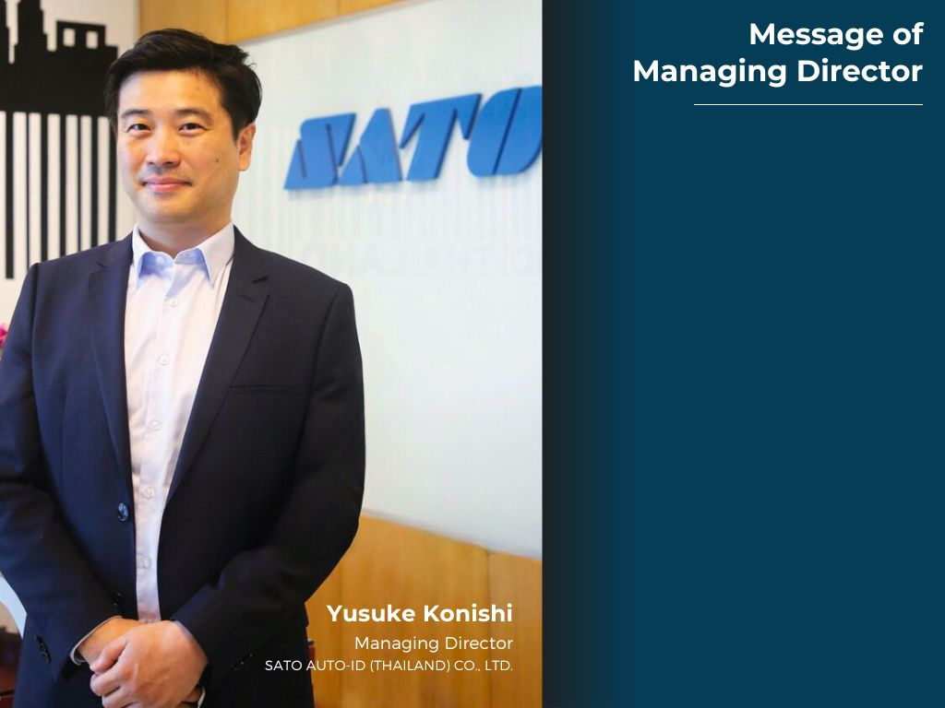
SATO is a pioneer and leading global provider of integrated Automatic Identification and Data Collection solutions that leverage barcode and RFID technologies. SATO manufactures innovative, reliable Auto Identification systems and offers complete solutions to businesses by integrating hardware, software, media supplies and maintenance services. Customers rely on SATO for accuracy, labor and resource savings helping to preserve the environment. Founded in 1940, SATO is publicly listed on the first section of Tokyo Stock Exchange in Japan. It has sales and support offices in over 20 countries and is represented globally through a world-class network of partners.
SATO Auto-ID (Thailand) Co., Ltd is full range support of Auto Identification as well we provide a wide range of products designed to suit different customers' needs, from simple bar code printing and scanning system to complex customized data collection and printing systems, including consumables such as seals, labels and carbon ribbon. We hope that we could assist supporting your business. In the meantime, you may also visit our website at https://satoasiapacific.com/thailand or contact our sales representative for further assistance accordingly.

Slide 9



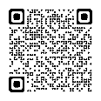


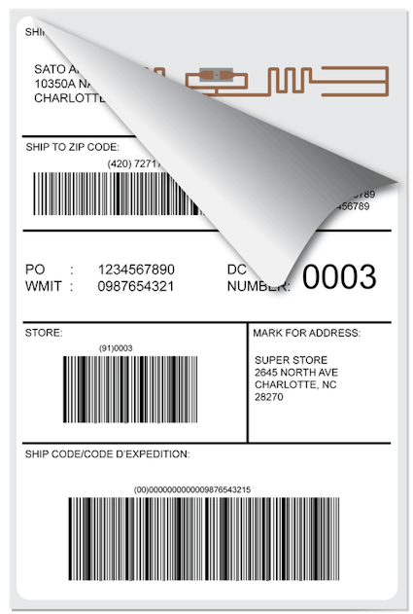


AUTO-ID TECHNOLOGY
The implementation of a successful barcode system starts with the symbol.
The code is selected based upon data requirements of application
and the capabilities of the scanning system used.
1D Barcode
Image recognition
Versatile 1D barcodes used to represent ID keys and attributes in a distribution environment.
Image recognition is a identify objects writing and actions in digital images.
2D Barcode
Voice recognition
The 2-D symbologies take advantage of both horizontal and vertical encodation to reduce
the symbol size and achieve character densities up to 2000 characters per square inch.
The voice recognition system within this solution allows user to operate the system using voice, and eliminates the need for handwriting and manual input through keyboard or touch screen.
RFID
Location tracking
SATO offers a wide array of UHF and HF encoding solutions to fit the application needs of today and the implementations
of technology in your future.
Better manage your assets and people with real-time tracking and visibility

Slide 10
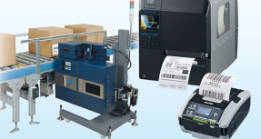
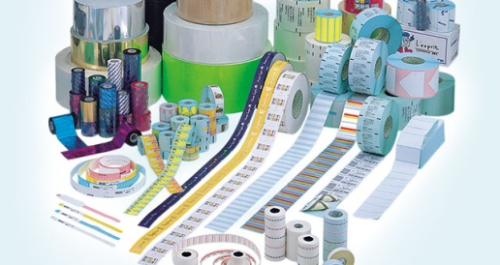
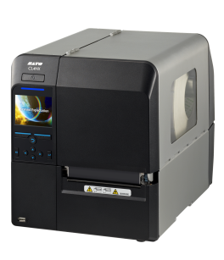
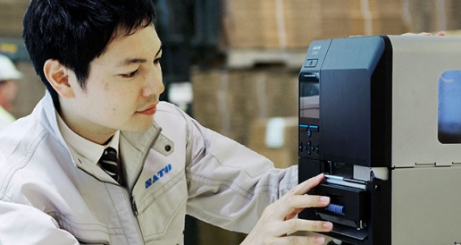
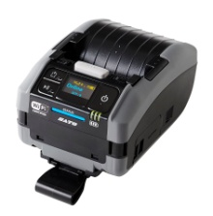

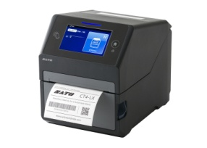
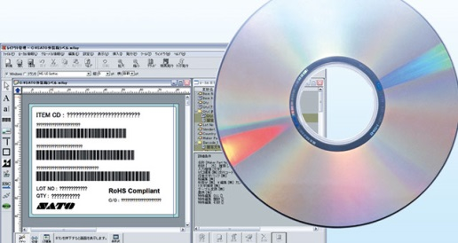
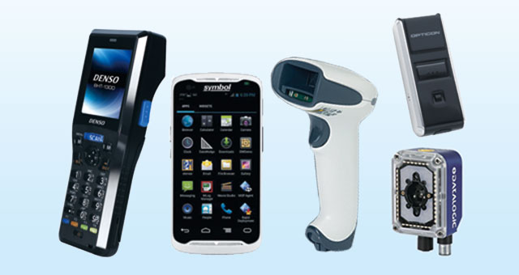
PRODUCTS & SERVICES
One-stop solution for products and services that answer to customers’ on-site challenges
Hardware
Consumables
Printers
Auto-labelers
Hand labelers
Labels
Tags, tickets
RFID
Carbon ribbons
SATO Printer
Maintenance support
Hardware maintenance
Regular servicing
Software
System peripherals
General-purpose software
Custom software
Scanners
Handy terminals
Connection tools

Slide 11

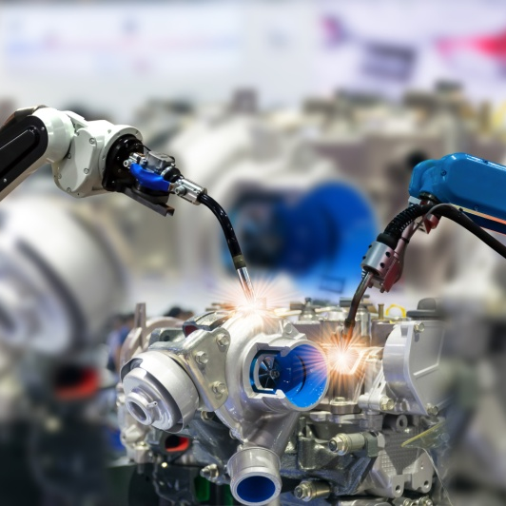
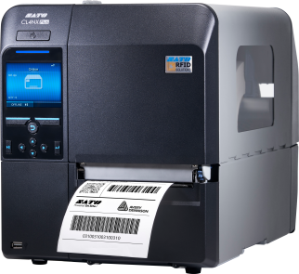
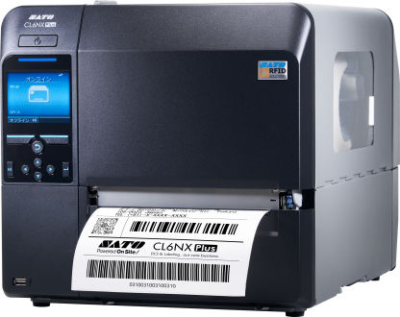

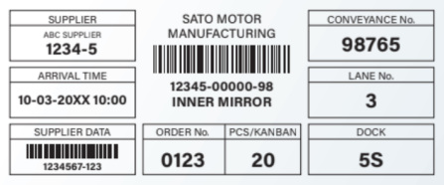
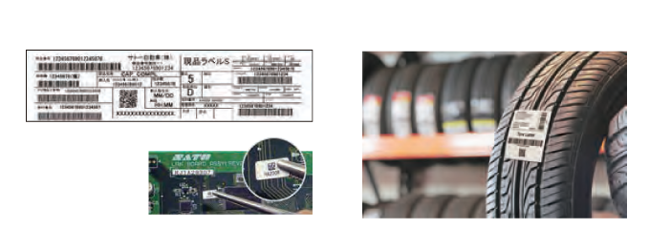
Manufacturing
SATO offers reliable solutions designed for use in harsh industrial environment to help manufacturers gain greater visibility and enhance the efficiency of their operations from the receipt of raw materials to the shipping of finished goods.
Through accurate identification and tracking within the manufacturing process,
manufacturers can uncover opportunities to eliminate unnecessary costs and
wastages as well as improve productivity of workers.
Traceability solutions: Location tracking technology and RFID track
products and workers with precision
Location management: Locate all assets in a factory or warehouse
Labeling solutions: For parts of various sizes and material
PDF Direct Print

Slide 12


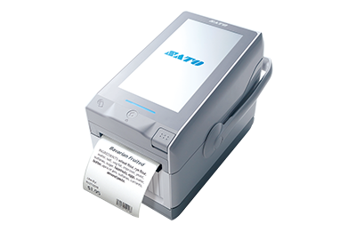
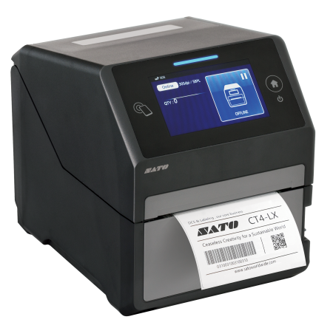
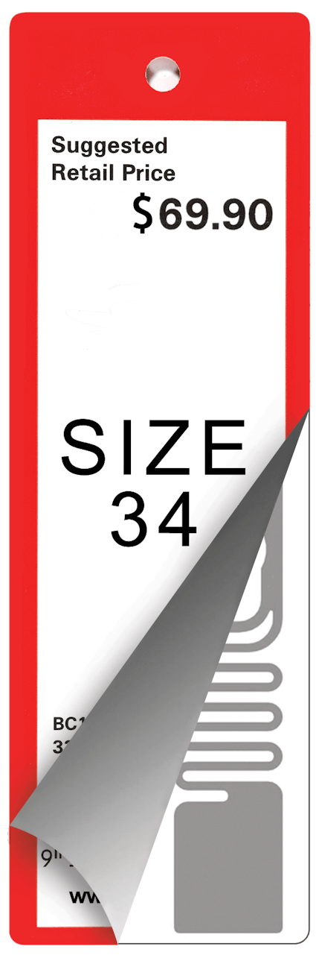

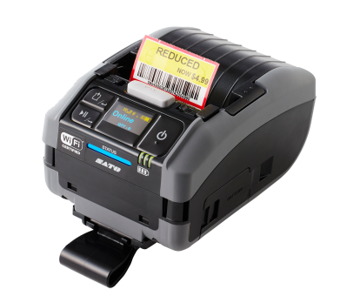
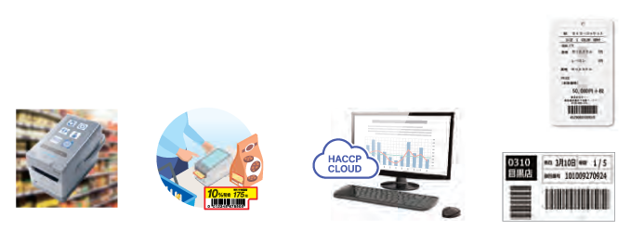
Retail
SATO offers reliable solutions designed for use in harsh industrial environment to help manufacturers gain greater visibility and enhance the efficiency of their operations from the receipt of raw materials to the shipping of finished goods.
FX3 supermarket app: For every label printing need
Self-serve coupons: Reduce food loss and employee workload
HACCP Cloud: Monitor critical control points
Daisharin SAAS: Streamline supply chain using RFID
RFID Tags
Food Safety

Slide 13

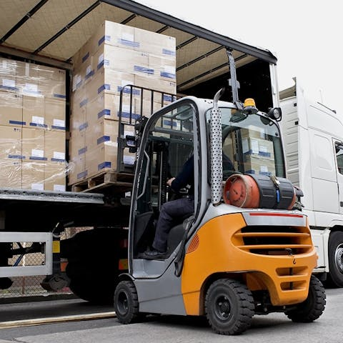
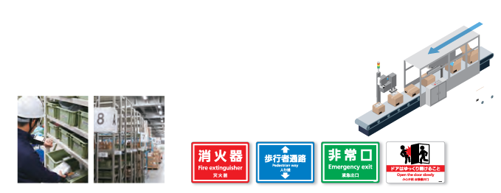
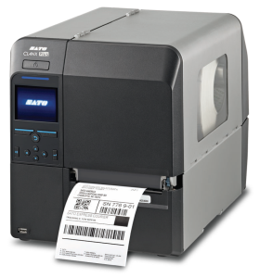
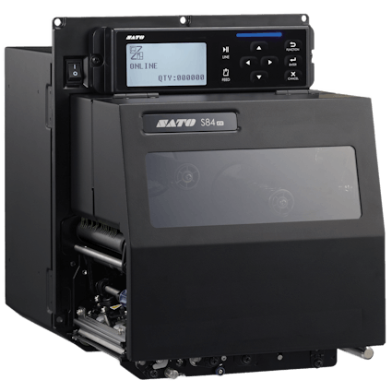
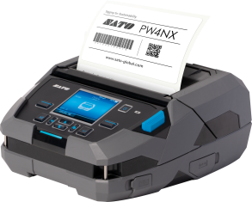
Transportation & Logistics
SATO barcode labels and RFID tags enable sensors to sort, direct and track parcels, pallets, and cartons through the transportation and logistics network without direct human intervention.
Today, real-time visibility of valuable assets is critical. Whether transporting
luggage or moving goods through a distribution center, every step between
receipt and delivery represents an opportunity for process improvement.
Warehouse navigation system: For better picking and stocking
productivity
Shipping automation: Seal random sizes, measure dimensions,
label automatically
Precaution labels: For a safer workplace

Slide 14


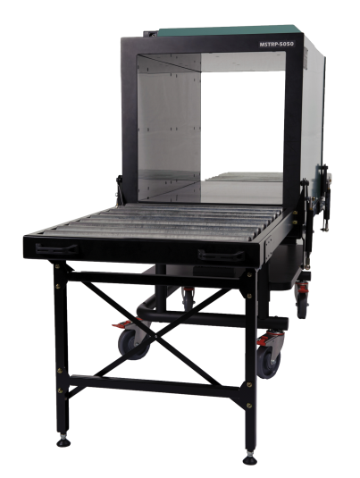
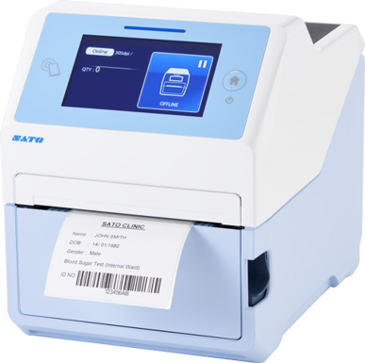
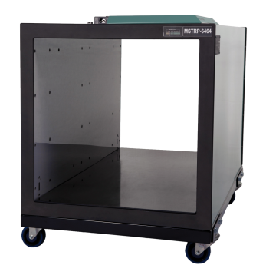
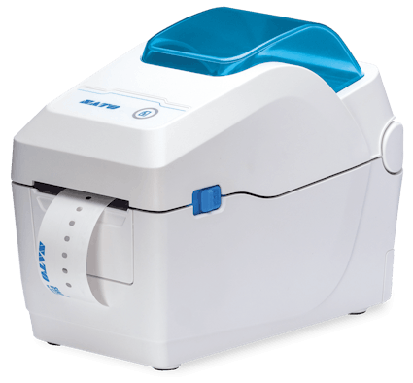

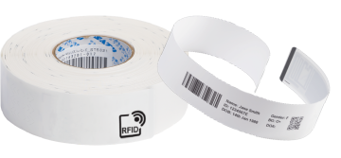
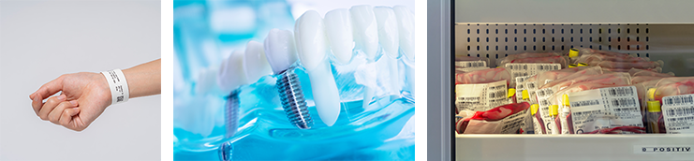
Healthcare
SATO delivers technology solutions across the processes of patient registration and discharge, specimen collection, lab tracking and verification, as well as pharmacy,
and asset management.
We help hospitals and clinics manage everything from devices, drugs, blood bags
and specimens to patients and employees. Our blood bag solution covers processes
such as automatic printing and applying of labels and can ensure accurate
stocktaking within seconds using our unique PJM RFID technology.
Our contactless UHF RFID wristband solution enhances comfort for patients and
lowers stress for care workers, adding to their performance. It also allows hospitals
to monitor the flows of patients between hospital wards to better optimize human
resources.
Wristband
Specimen/
Prescription Labels
Blood Bank

Slide 15

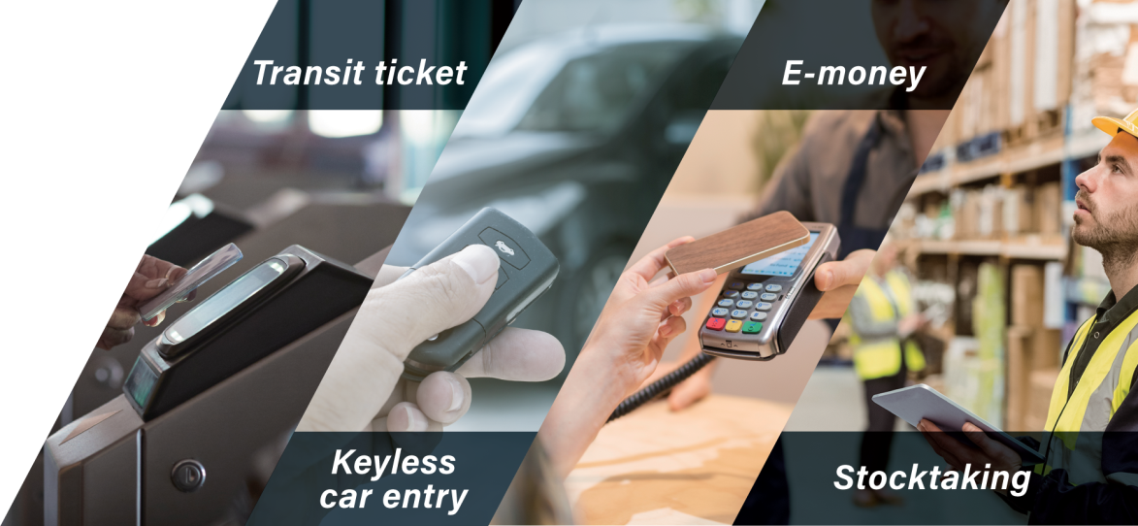
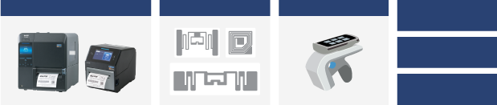
Accelerate Your Business
with RFID
What is RFID?
Short for Radio Frequency Identification, RFID is one of the auto-ID technologies that is
anticipated to enable advanced information services and bring us closer to a ubiquitous
society.
Besides barcodes, two-dimensional (2D) barcodes and magnetic stripe cards that are
conventionally used to carry data, newer technologies such as RFID, voice recognition
and biometrics are now being introduced at a greater speed for improving business
operations and security.
As RFID develops and its product lineup continues to expand, the technology is
set to become an increasingly important tool for item-level identification, traceability, environmental sustainability and many other applications in various industries
such as manufacturing, logistics, retail, service and transportation.
SATO’s RFID lineup
RFID-ready printers
RFID tags/labels
Peripherals
Support for
system setup
Consultation
on implementation
Know-how
from experience
SATO offers total RFID support for customers, starting from sourcing
readers/writers most suited to your usage, to developing and providing
the software you need.

Slide 16
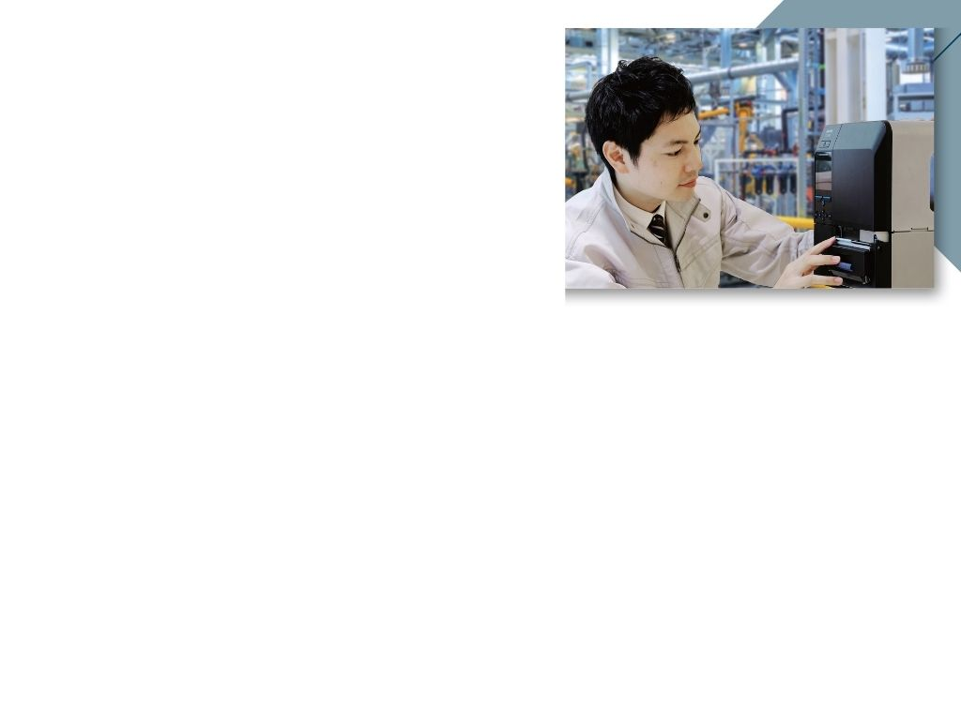
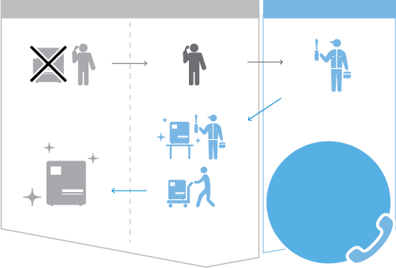

MAINTENANCE SERVICES
Our printer maintenance service offers preventative maintenance support as well as speedy repair so as to ensure smooth operations for your business with minimum downtime.
Depending on your needs such as printer usage level, you can choose from various types of maintenance programmes :
FEATURE | Manufacturer Warranty Coverage | Extended Warranty / Maintenance Agreement Coverage
Total years of coverage | 1 Year | 3 to 5 Years
On-site support | x | 
Preventative maintenance | x | 
Service cost waiver | x | 
Priority support | x | 
Expendable parts replacement | * | 
Remote issue diagnosis & support | x | 
Repair process for user with M.A.
USER
SATO
Factory
IT Dept.
Printer down
Go to factory
Go on-site
for repairs
CALL TO
SATO
Printer up
Send back printer

Slide 17











































































Slide 18
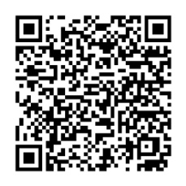
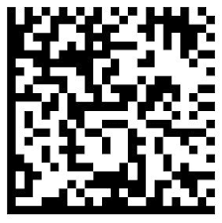
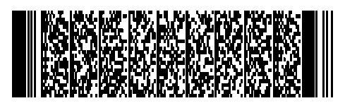
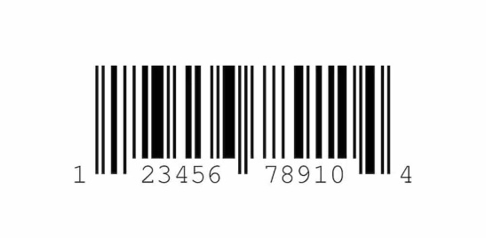




Software for label design
Mr. Chonvit Sukhumjitpittayotai
SATO AUTO-ID (THAILAND) CO.,LTD

Slide 19

Software Label Design
โปรแกรมสำหรับออกแบบฉลากสินค้าและบาร์โค้ด
ช่วยให้ธุรกิจของคุณสร้างฉลากได้อย่างรวดเร็ว แม่นยำ
และสวยงาม โดยไม่ต้องมีพื้นฐานด้านโปรแกรม
เหมาะอย่างยิ่งสำหรับผู้ใช้งานตั้งแต่ธุรกิจขนาดเล็กไปจนถึง
องค์กรขนาดใหญ่
✔ ออกแบบฉลากตามความต้องการ ✔ ใส่ข้อความ รูปภาพ โลโก้ ✔ สร้างบาร์โค้ด/QR Code อัตโนมัติ ✔ ดึงข้อมูลจากฐานข้อมูล เช่น Excel, SQL, ERP ✔ เชื่อมต่อกับเครื่องพิมพ์บาร์โค้ด

Slide 20




How to Create a Barcode
หมายเลขประจำตัวสินค้า
พิมพ์บาร์โค้ด
สร้างบาร์โค้ด

Slide 21





SATO Solution
Stock Control Solution
Traceability Solution
RFID Solution

Slide 22



THANK YOU
Mr. Chonvit Sukhumjitpittayotai
Assistant Sales Manager
Please feel free to contact us if you need any further information.
Head Office (Samutprakarn) Eastern Branch (Chonburi)
Tel : 02-481-7359 Tel : 038-338-202 - 3
Fax : 02- 481-7373 Fax : 038-338-204
Email : marketing-stc@sato-global.com
Website : www.satoasiapacific.com/thailand
Facebook : www.facebook.com/satoautoidthailand
Linkedin : https://www.linkedin.com/company/sato-auto-id-thailand

